Slide 1
Streams
Streams allow an artefact to communicate with some external device.
another artifact
another artifact
network
network
modem
modem
artefact
scanner
printer
file
file
keyboard
screen
Rather than have a separate Application Programmer Interface (API)
for every kind of device a stream is allows the artefact to read from
or write to it and not be concerned about what it is connected to.

Slide 2
Input & Output Streams
input
output
artefact
(read from)
(write to)
Data leaves the artefact on an output stream (e.g. System.out).
Data enters the artefact on an input stream (e.g. System.in).
(It is easy to get these two directions confused!)
Stream operations, particularly input operations are
fraught with problems and throw many exceptions!

Slide 3
Data & Print (ascii) Streams
Data Streams
Print Streams
Java specific, binary format
Open, ascii format
Smaller (or faster)
Larger (or slower)
Machine readable
Human (& machine) readable
output - write()
output - print() & println()
input - read()
input - read() & readLine()
output - DataOutputStream
output - PrintWriter
input - DataInputStream
input - BufferedReader
(One other type of stream is ObjectStream which allows an
object instance to be serialised and then stored or moved!)

Slide 4
Output Data File Streams - 1 open the stream
from an upgraded RadioShow
DataOutputStream storeHere = null;
try {
storeHere = new DataOutputStream(
new FileOutputStream( ”show.dat"));
} catch ( IOException exception) {
System.err.println(”The file show.dat could not be opened ”);
System.exit( -1);
} // End try/catch
Data
Output
Stream
File
Output
Stream
artefact
show.dat

Slide 5
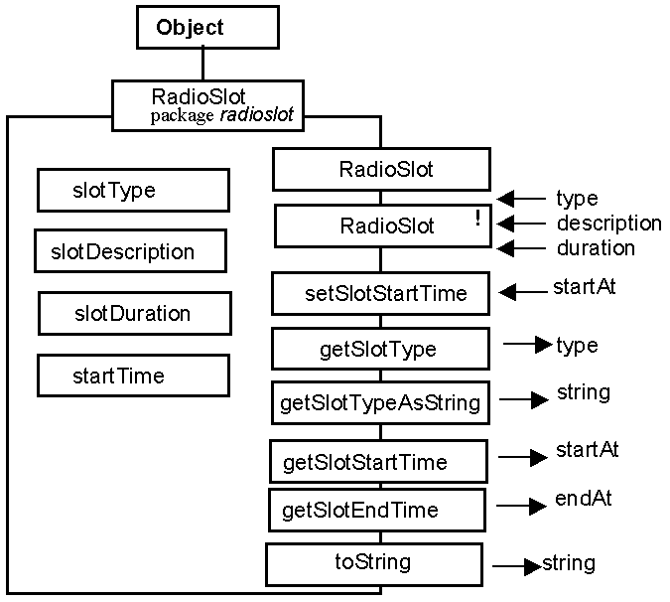
Output Data File Streams - 2 write to the stream
from the RadioSlot class
public void writeSlot( DataOutputStream theStream)
throws java.io.IOException {
theStream.writeUTF( this.slotDescription());
theStream.writeInt( this.getSlotType());
this.getSlotStartTime().writeTime( theStream);
this.slotDuration().writeTime( theStream);
} // End writeSlot.
The state of a RadioSlot is
defined by the composite value
of its four attributes which
are written to the stream by
this method.

Slide 6
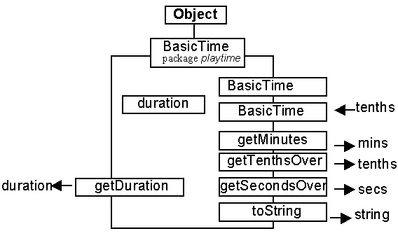
Output Data File Streams - 2 write to the stream ctd.
from the BasicTime class
public void writeTime( DataOutputStream theStream)
throws java.io.IOException {
theStream.writeInt( this.getDuration());
} // End writeTime.
The state of a PlayTime
instance is defined by the value
of its duration instance which
iswritten to the stream by
this method.

Slide 7
Output Data File Streams - 3 close the stream
try {
storeHere.close();
} catch IOException exception) {
System.err.println("Transactions file could not be closed ”);
System.exit( -1);
} // End try catch.
Information may not be saved securely in the file until it is closed.
The file will contain a sequence of RadioSlot records.
Each record will consist of:
a String recording the description of the slot.
an integer representing the type of the slot
an integer representing the start time of the slot.
an integer representing the duration of the slot

Slide 8
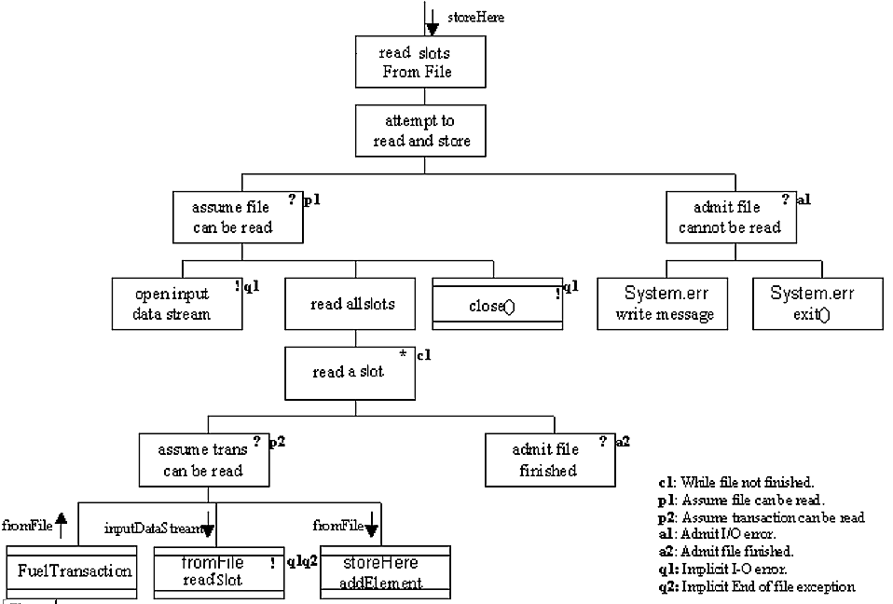
Input Data File Streams - design

Slide 9
Input Data File Streams - 1 open the stream
try {
readFromHere = new DataInputStream(
new FileInputStream( ”show.dat"));
File
Input
Stream
Data
Input
Stream
artefact
show.dat

Slide 10
Input Data File Streams - 2 read from the stream
from the RadioSlot class
public void readSlot( DataInputStream theStream)
throws java.io.IOException {
this.description = theStream.readUTF();
this.slotType = theStream.readInt();
this.startTime.readTime( theStream);
this.slotDuration.readTime( theStream);
} // End readSlot.
from the BasicTime class
public void readTime( DataInputStream theStream)
throws java.io.IOException {
this.duration = theStream.readInt();
} // End readTime.
The RadioSlot instance is restored by reading the four pieces
of information from the stream and using them to set the state
of the four attributes.

Slide 11
Input Data File Streams - 2 read all slots
while ( fileNotFinished) {
try {
fromFile = new RadioSlot();
fromFile.readSlot( readFromHere);
storeSlots.addElement( fromFile);
System.out.print( ".");
} catch ( EOFException exception) {
System.out.println( "\n" + storeHere.size() +
" transactions read from file.");
fileNotFinished = false;
} // End try/catch
} // End while.
All information from the file is read and used to set the state of a series of RadioSlots which are stored in the Vector storeSlots

Slide 12
Input Data File Streams - 3 close the stream
readFromHere.close();
} catch ( IOException exception) {
System.err.println("Transactions file could not be “ +
“read successfully ...\nThis " +
" program is finishing .... ");
System.exit( -1);
} // End try/catch
This is a common pattern - open the stream, read every element
from the stream and do something with it, then close the stream.
Are input streams are more difficult
to work with than output streams??

Slide 13
Data Streams - design advice
For every class that introduces an attribute provide:
public void readThing( DataInputStream theStream) throws ..
public void writeThing( DataOutputStream theStream) throws
(Remembering to use super.readThing() and
super.writeThing() as appropriate)
… and then the information from the Object can be written
to, or read from, any data stream.

